Slide 1


DO NOW – Practice Exam Question – 5 minutes Researchers wanted to investigate the ongoing health effects of working as a medical student at a busy city hospital. Participants were first year medical students chosen from a hospital close to the university where the researchers worked. They were followed throughout their medical training. Researchers met participants once a year over an eight-year period. 1. Identify the sampling method of this study (1 mark) 2. Identify a strength and weakness of this sampling method (1 mark) 3. When researchers met participants, they were interested in collecting quantitative data to measure health effects. Name one subjective quantitative measure and one objective quantitative measure that might have been used in this study. (2 marks)
Activate Prior Knowledge/skill development

Slide 2
DO NOW – Practice Exam Question – 5 minutes Researchers wanted to investigate the ongoing health effects of working as a medical student at a busy city hospital. Participants were first year medical students chosen from a hospital close to the university where the researchers worked. They were followed throughout their medical training. Researchers met participants once a year over an eight-year period. 1. Identify the sampling method of this study (1 mark) Convenience/opportunity 2. Identify a strength and weakness of this sampling method (2 marks) Strength: Cost and resource efficient. Weakness: Not representative of population.
Activate Prior Knowledge/skill development

Slide 3
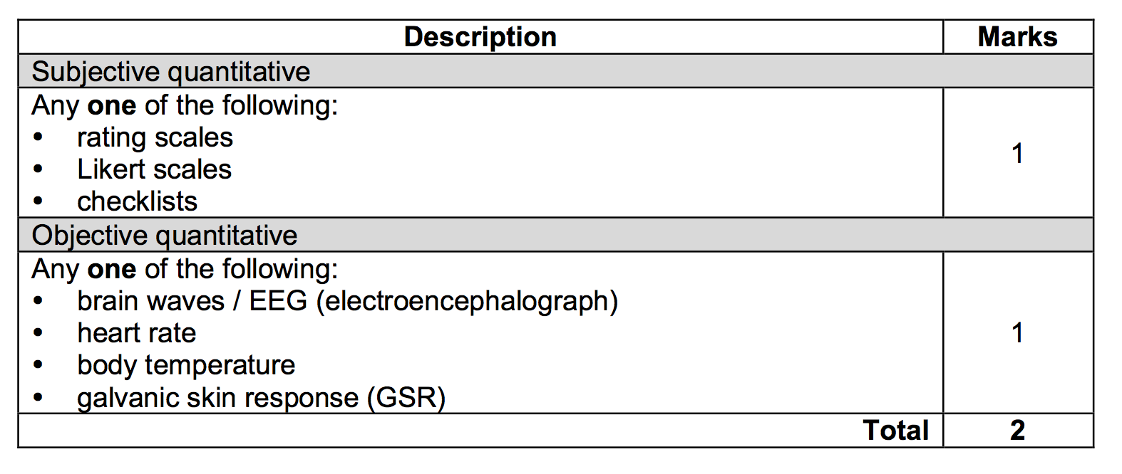
DO NOW – Practice Exam Question – 5 minutes Researchers wanted to investigate the ongoing health effects of working as a medical student at a busy city hospital… 3. When researchers met participants, they were interested in collecting quantitative data to measure health effects. Name one subjective quantitative measure and one objective quantitative measure that might have been used in this study. (2 marks)
Activate Prior Knowledge/skill development

Slide 4

Learning Intention
I will be able to analyse the results of the study.
Success Criteria
I will complete my results of my investigation.

Slide 5
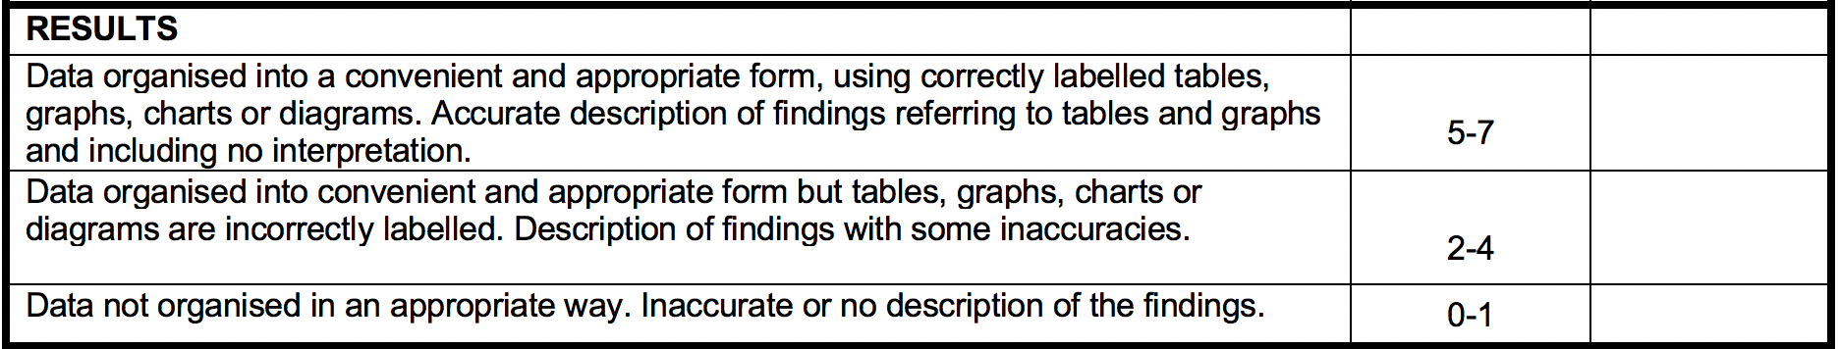
Analysing your data
Step 1:
Read the below screenshot from your marking key
2. Open up your data on SEQTA
TASK 2: Using the below slides work out what tables and graphs you wish to show.
Remember your descriptive statistics should relate to the hypothesis and be talked about in your interpretation section and discussion section.
THESE CAN BE PRE-PREPARED ON PAPER OR PRINTED

Slide 6
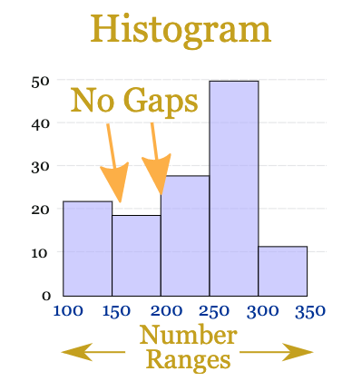
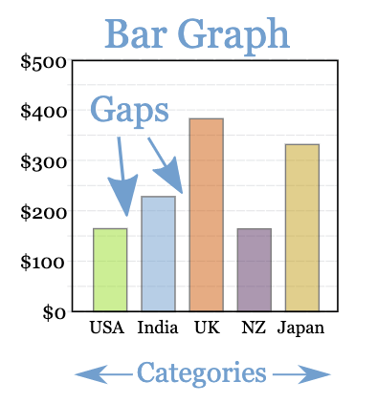
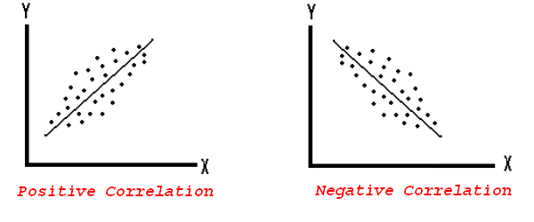
Bar Graph
Tips on constructing your graphs
A title that includes both variables
Labeled axes with units
Y axis ( up / down) always shows the dependent variable (the one being measured)
X axis (left / right) always shows the independent variable (the one being manipulated / changed)
Histogram
Scatterplot
Used when looking at the frequency of ONE numerical data set (i.e one variable that can be measured)
Used when there is ONE numerical data set and ONE categorical data set that you are measuring the relationship between
Used when there are TWO continuous data sets that you are measuring the relationship between

Slide 7
Analysing your data
Step 4: Write an accurate description of finding referring to tables and graphs – no interpretation of findings! That is for your discussion.
Examples from different research:
“Graph 1. shows that prior to exercise mood was rated at X, post exercise mood score moved to X”
“Graph 3 compares first born and later born participants and the four personality traits. It can be seen that first borns on average had a higher score for leadership than later borns; 4.5 and 3.5 respectively.”

Slide 8
Examples of a results paragraph
Example

Slide 9
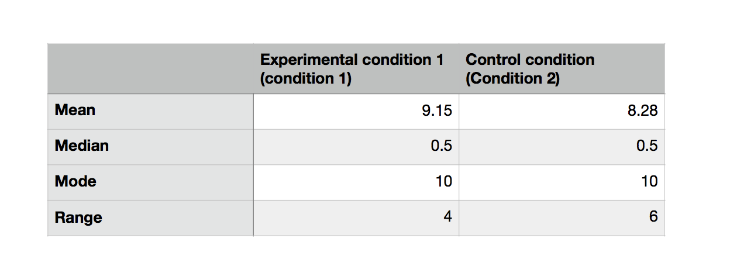
Think Pair Share: Compare to the rubric
Example
What is done well? What could be improved?

Slide 10
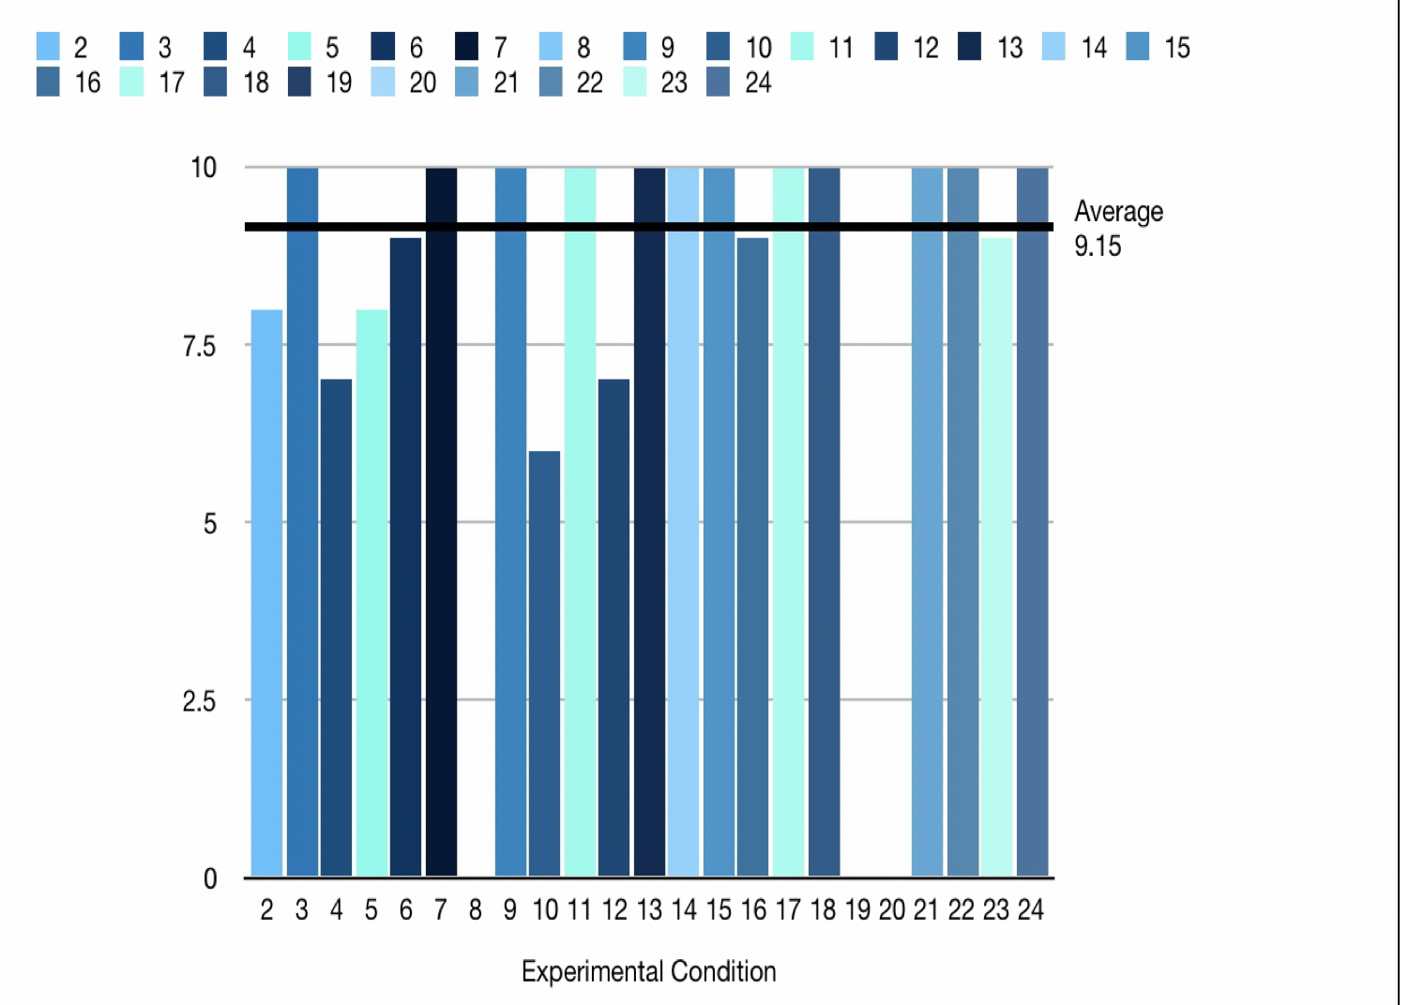
Think Pair Share: Compare to the rubric
Example
What is done well? What could be improved?

Slide 11
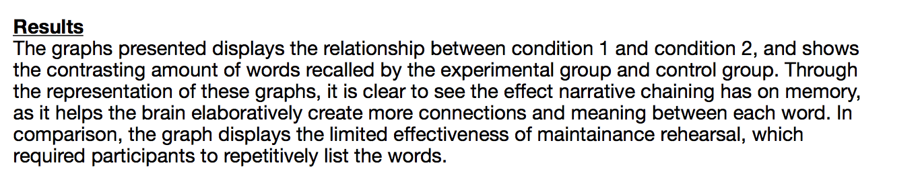
In pairs: What was done well? What could be improved? Compare to the rubric
Example

Slide 12

Homework
Before your next lesson, you must have:
Finished your tables and graphs
If you need support message me on SEQTA.

